Slide 1
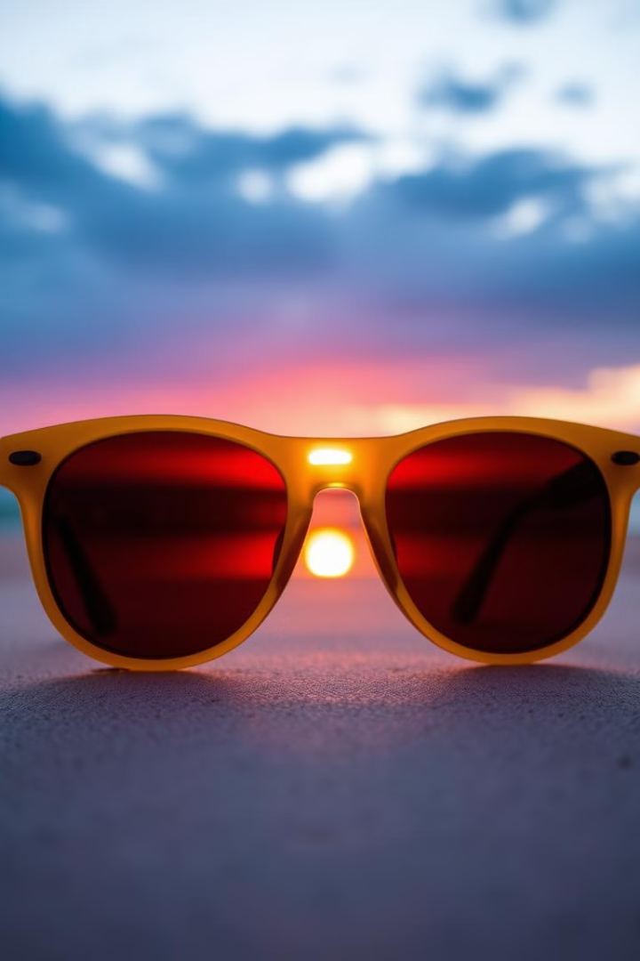
Introducing auraVue: The Future of Adaptive Eyewear
Welcome to our pitch for auraVue. We're excited to share our vision for the future of adaptive eyewear.
Notes:
1

Slide 2
The Problem: Challenges of Traditional Sunglasses
Traditional sunglasses often lack adaptability, failing to provide optimal vision in dynamic lighting conditions. This forces users to compromise between functionality and style.
Moreover, the current market lacks stylish and functional sunglasses that seamlessly adapt to changing light conditions. This leaves consumers with a limited choice, sacrificing either performance or aesthetics.
Notes:
2

Slide 3
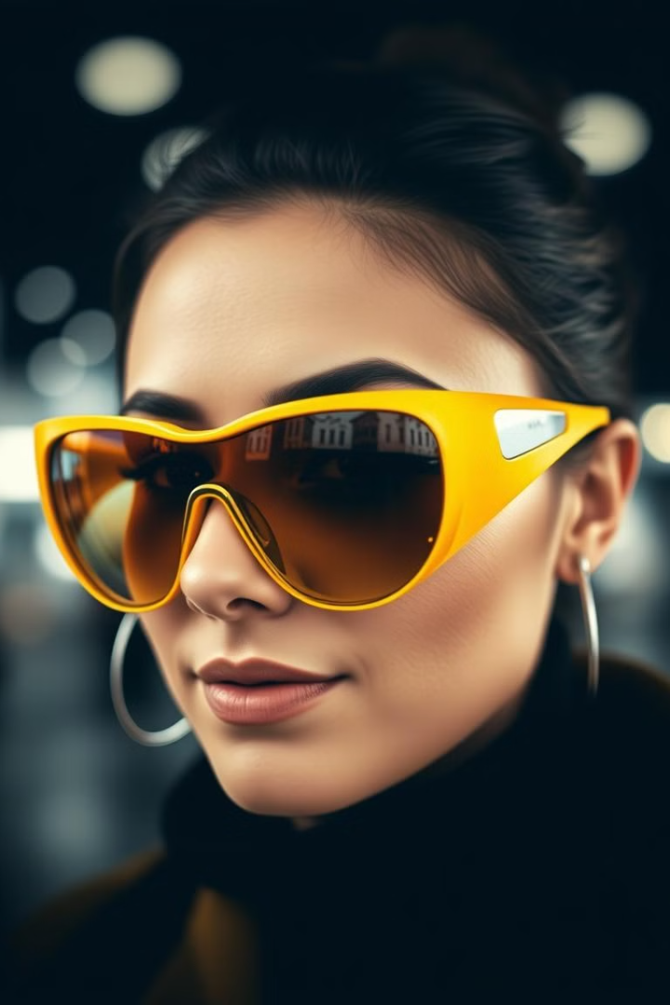
Our Vision: Empowering Modern Lifestyles
Adaptability
Style
auraVue seamlessly adapts to various lighting conditions, providing optimal vision for diverse environments and activities.
Our sleek and modern designs offer a wide range of styles to suit different preferences and personalities.
Convenience
auraVue is user-friendly, eliminating the need for manual adjustments or multiple pairs of sunglasses.
Notes:
3

Slide 4
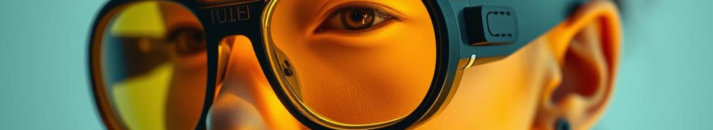




Our Solution: Stylish, Tech-Enabled Sunglasses
Adaptive Lens Technology
Long-lasting Battery
Smart Connectivity
Fashion-forward Designs
auraVue sunglasses boast a long-lasting battery life, allowing users to enjoy seamless functionality throughout the day.
Integrated smart connectivity enables seamless integration with smartphones and other devices, enhancing the user experience.
Our proprietary adaptive lens technology automatically adjusts to varying light conditions, ensuring optimal vision in any environment.
auraVue offers a wide range of stylish frames and lens colors, catering to diverse fashion tastes and preferences.
Notes:
4

Slide 5
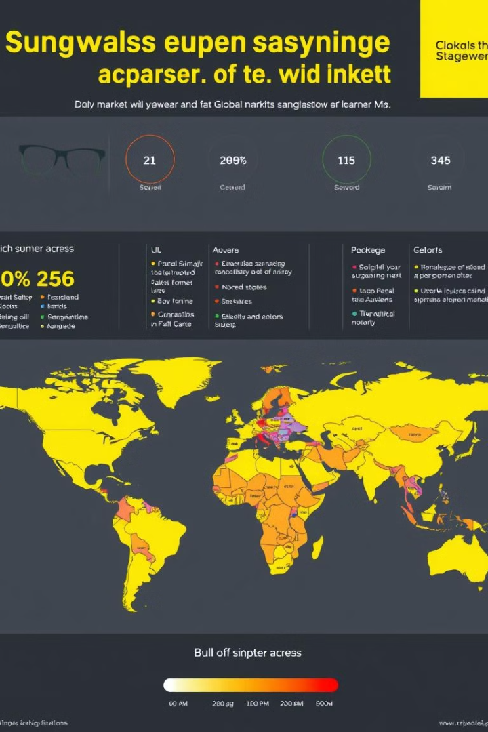
Market Opportunity: Sizeable and Growing
200M
$150M
Global Eyewear Market
US Sunglasses Market
The global eyewear market is a sizeable and growing industry, with a projected value of over $200 billion by 2025.
The U.S. sunglasses market alone is worth over $150 million, showcasing significant demand for high-quality eyewear.
10%
Adaptive Eyewear Growth
The demand for adaptive eyewear is expected to grow at a 10% CAGR, fueled by increasing consumer awareness and adoption of technological advancements.
Notes:
5

Slide 6
Competitive Advantage: Innovative Technology and Design
Adaptive Lens Technology
1
Our proprietary adaptive lens technology sets auraVue apart from competitors, offering unparalleled functionality and user experience.
Sustainable Materials
2
We utilize eco-friendly and durable materials, aligning with growing consumer demand for sustainable products.
Fashion-forward Designs
3
auraVue's sleek and stylish designs cater to diverse fashion tastes, offering a range of frame options to complement different looks.
Notes:
6

Slide 7




Business Model: Driving Profitability and Scalability
Direct-to-consumer Sales
1
Our direct-to-consumer model allows us to control pricing and distribution, maximizing profitability.
Partnerships
2
We leverage strategic partnerships with retailers and distributors to expand reach and market penetration.
Online and Offline Presence
3
We maintain a robust online presence through our website and social media channels, complemented by a network of physical retail locations.
Subscription Model
4
Our subscription model provides ongoing revenue streams and fosters customer loyalty.
Notes:
7

Slide 8
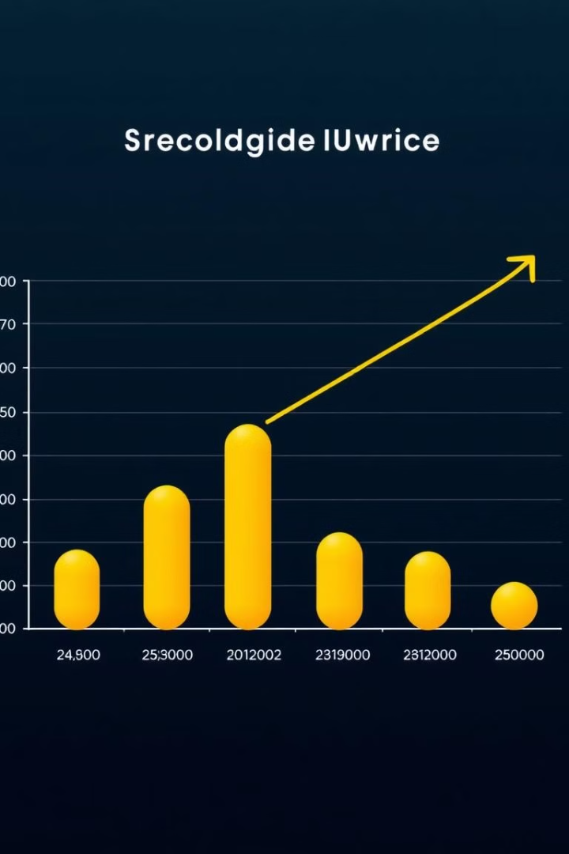
The Ask: Fueling Growth and Expansion
We seek $5 million in funding to accelerate our growth and expansion plans. This investment will enable us to scale production, expand our marketing efforts, and develop new product lines. We are confident that auraVue has the potential to revolutionize the eyewear industry and become a leading player in the adaptive eyewear market.
Notes:
8

